Slide 1
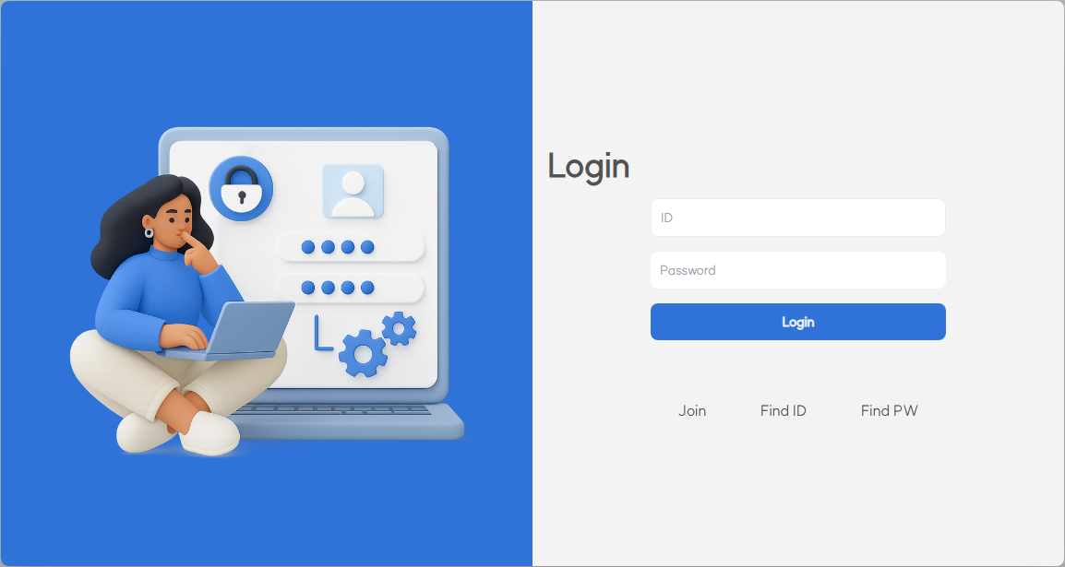
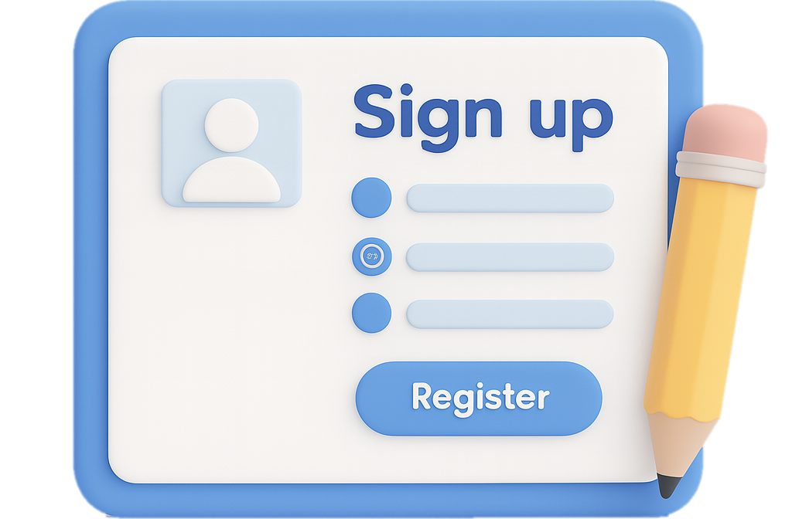


SIGN
IN
SIGN UP

Slide 2

SIGN UP
UP
SIGN
IN

Slide 3
CERTIFY
HUB
WALLET
WORK BOOK
COMMUNITY

Slide 4


